Slide 1
Are We Just Playing Around with AI?
Beyond the Pipeline of Automated Transcription
Luigi Sausa
Università di Napoli L'Orientale · DAAM · HELLO Campania
Seminar on Language Documentation and Interdisciplinarity · 11 March 2026

Slide 2
1. INTRODUCTION
The Promise and the Rush
A quiet “revolution” in fieldwork
Over the last 3–4 years, tools like WhisperX and pyannote have entered language documentation workflows, often without formal methodological training.
This is not a tutorial, and not an endorsement.
It is a critical reflection based on my fieldwork experience across two multilingual diasporic contexts.
"AI has the potential to change the landscape of sociolinguistic research — but will it change how we use it responsibly?"
Kelly-Holmes, Journal of Sociolinguistics, 2024
The central question
Are we just playing around with AI, or do we actually know what we're doing with it?
Luigi Sausa · L'Orientale, Naples · 11 March 2026
2 / 15

Slide 3
2. THE PIPELINE
How It Works - In Theory
Audio
Recording
WhisperX
ASR
Wav2Vec2
Alignment
Pyannote
Diarization
ELAN
Fieldwork data
(WAV / MP3)
Transcription +
word timestamps
Phoneme-level
alignment
Speaker ID
segmentation
Annotation
& analysis
The appeal
⚠ Developer's own admission
70× real-time speed
Word-level timestamps
Speaker labels for multi-party data
Direct import to ELAN
"Overlapping speech is not handled particularly well by Whisper nor WhisperX… Diarization is far from perfect."
Bain et al., INTERSPEECH 2023 / WhisperX GitHub
Luigi Sausa · L'Orientale, Naples · 11 March 2026
3 / 15

Slide 4
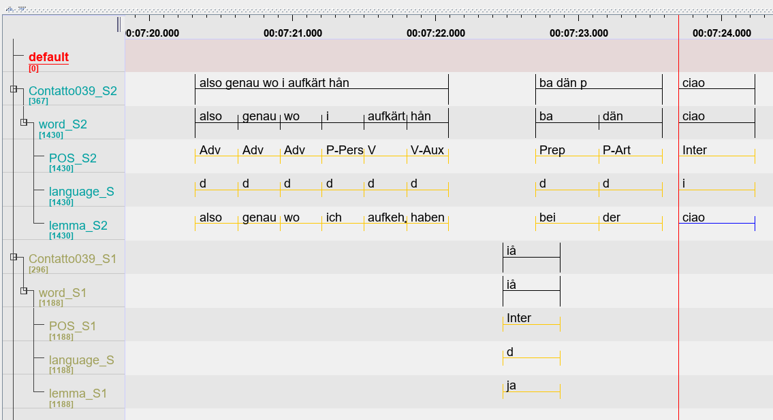
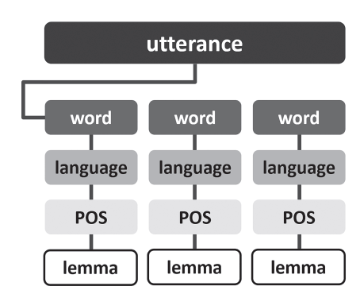
2. THE PIPELINE
Elan Template Example
Corpus KONTATTO, cfr. Ciccolone & Dal Negro (2021)
Luigi Sausa · L'Orientale, Naples · 11 March 2026
4 / 15

Slide 5
2B. ACCESSIBILITY & RISKS
AI for Everyone - No “Code” Required
💬
☁
💻
Ask an LLM to write the code
Run it on a cloud GPU
Or run it locally
ChatGPT or Claude writes a complete WhisperX pipeline in seconds from plain language. No Python knowledge required.
RunPod, Google Colab, Paperspace provide powerful GPUs for a few cents/hour. Upload your audio, run the script, download the transcript.
Apple Silicon (M-series) or NVIDIA GPU needed for usable speed. Without hardware, local inference can take hours per recording.
⚠ The democratisation gap
Accessibility of the tool ≠ understanding of what the tool does. A researcher who asks an LLM to write their WhisperX pipeline has no guarantee of knowing: which model version is running, what language detection threshold is set, how diarization parameters affect output, or what assumptions are encoded in the defaults. The code works, but the methodology is opaque.
Luigi Sausa · L'Orientale, Naples · 11 March 2026
4 / 15

Slide 6
2C. DATA PRIVACY & ETHICS
Your Data, Their Servers?
Tool / Workflow
Audio data goes to...
Privacy risk
WhisperX on your own machine
Audio never leaves your device
✓ Fully local inference
WhisperX on RunPod / Colab
Your audio files are uploaded to external servers
⚠ Data shared with cloud provider
Google Speech-to-Text API
Audio processed and potentially retained by Google
✗ Data sent to Big Tech
OpenAI Whisper API
Audio uploaded to OpenAI (may be used for training)
✗ Data sent to OpenAI
AssemblyAI / Rev / Otter.ai
Audio processed and stored on commercial platforms
✗ Data sent to third parties
Fieldwork recordings often contain sensitive personal, cultural, or religious content. Existing data ethics frameworks (ELDP, AILLA, PARADISEC) do not yet explicitly address cloud-based processing. Researchers should document their processing workflow as part of data management plans.
Luigi Sausa · L'Orientale, Naples · 11 March 2026
5 / 15

Slide 7
2D. UNDER THE HOOD — ARCHITECTURE & PHILOSOPHY
Not Transcription but Prediction!
How Whisper / WhisperX actually works
HuBERT — a different philosophy
Raw audio
waveform
Mel-
spectrogram
Transformer
Encoder
Autoregressive
Decoder
Text
output
Self-supervised
Pre-trained on unlabelled audio — no transcriptions needed. Learns by predicting masked acoustic units.
Your .wav file
Freq. × time
representation
Contextualised
acoustic embeddings
Predicts most probable
next token
"Probable"
transcript
Bottom-up representations
Learns acoustic structure from the signal itself, not from association with standard text.
The key insight
Better for low-resource?
Whisper does not analyse phonemes and map them to graphemes. It asks: given this acoustic signal, what text sequence is most probable, based on 680,000 hours of mostly high-resource, largely English training data? The output reflects training distribution, not acoustic reality.
Potentially — but fine-tuning still requires annotated data. Pre-training can run on raw field recordings.
The trade-off
Baevski et al. 2020 (wav2vec 2.0) · Hsu et al. 2021 (HuBERT) · Radford et al. 2022 (Whisper)
Even more opaque than Whisper. Interpretability drops; technical barrier rises.
Luigi Sausa · L'Orientale, Naples · 11 March 2026
6 / 15

Slide 8
3. THE FIELDWORK
Case 1 — Arab-Indonesian Communities in Java
Context
What the pipeline does
Languages in contact:
Arabic (Hadrami ??) ↔ Indonesian (colloquial) ↔ Javanese
Speech events:
Spontaneous conversation, religious discourse, family interaction
Frequent code-switching, mid-sentence language shifts, overlapping turns
Arabic → normalised to Modern Standard Arabic
Javanese → ignored or 'hallucinated' in Indonesian
Code-switches mid-sentence → assigned to single language label
Overlapping turns → cut or wrongly attributed by pyannote
Richest interactional moments → most distorted output
Luigi Sausa · L'Orientale, Naples · 11 March 2026
7 / 15

Slide 9
3. THE FIELDWORK
Case 2 — Filipino Heritage Speakers in Campania (HELLO Campania)
Context
What the pipeline does
Languages in contact:
Tagalog ↔ Italian (Neapolitan-influenced) ↔ emerging Filippin-Italian converging elements?
Generations:
G1 (migrant) and G2 (born/raised in Italy) — different competences, different strategies
Colloquial Tagalog → underrepresented in training data → high WER
Regional Southern Italian phonology → further increases errors
S1↔S2 mixed turns → diarization confuses speakers and language
Possible Emerging Filippin-Italian features → invisible to the model
Same structural failure as Case 1: different context, same pipeline limitations
Luigi Sausa · L'Orientale, Naples · 11 March 2026
8 / 15

Slide 10
3. THE FIELDWORK
Two Contexts, Same Structural Failures
Issue | Java (Arabic-Indonesian) | Campania (Filipino-Italian)
Underdocumented variety | Non-standard Arabic, Javanese | Colloquial Tagalog, Filippin-Italian
Code-switching handling | Not recognised | Not recognised
Speaker overlap | Cut or misattributed | Cut or misattributed
Hallucination risk | High (Javanese → Indonesian) | Medium (Tagalog → English/Spanish)
Training data representation | Very low | Low
(Guillaume et al. 2022, Japhug; Li et al. 2024, Khinalug — same pattern documented independently for other endangered languages)
Luigi Sausa · L'Orientale, Naples · 11 March 2026
9 / 15

Slide 11
4. FAILURE POINTS
A. Technical Failures of the Tools
Code-switching blindness
Overlapping speech → lost data. “See ya CA!”
The model picks one language per segment and transcribes everything in it- it has no mechanism to detect language shift mid-utterance.
Pyannote assigns each moment to one speaker only. Speaker overlap — the interactionally richest data — is systematically destroyed.
Normalisation toward standard varieties
False precision of timestamps
Arabic-Indonesian semiotic register → Modern Standard Arabic. Colloquial Tagalog (or regional languages) → Standard Filipino. Outputs are linguistically plausible but pretty much wrong.
Numeric timestamps create an aura of scientific objectivity. They mask the fact that every segmentation boundary is an interpretive decision!!
“Hallucination” (blunt lies) on undocumented varieties
When the model doesn't recognise a language, it generates coherent text in a related one rather than flagging uncertainty.
Luigi Sausa · L'Orientale, Naples · 11 March 2026
10 / 15

Slide 12
4. FAILURE POINTS
B. Researcher-Side Failures
Confirmation bias
The black-box problem
The transcript 'looks right' — the researcher accepts it if their competence in the target language is limited.
We do not know what data these models were trained on. Almost no one in a linguistics department has the training to evaluate model biases.
Workflow lock-in
Critical AI literacy gap
Once an AI transcript exists, re-checking manually feels redundant. Errors become embedded in the dataset.
We adopt these tools without the methodological vocabulary to assess their outputs. (Maly et al. 2025, AI & Society)
Analysis built on artefacts
If pyannote cuts a turn wrongly, the researcher may unknowingly build their conversation analysis around that artificial segmentation.
Luigi Sausa · L'Orientale, Naples · 11 March 2026
11 / 15

Slide 13
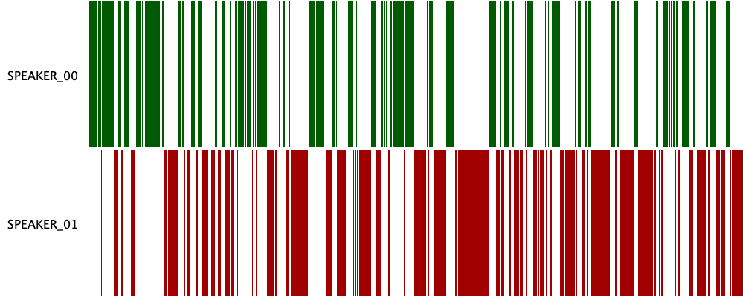
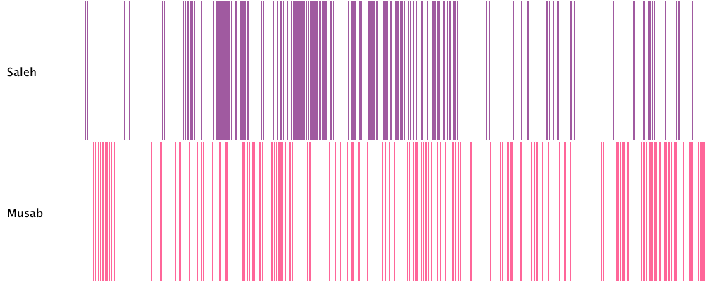
4. FAILURE POINTS — EXAMPLE
What the Output Looks Like: WhisperX vs. Manual Transcription
WhisperX output (density plot)
Manual density plot
[ Insert screenshot of WhisperX JSON / SRT output
showing language confusion and speaker label errors
on a real fieldwork segment ]
[ Insert ELAN screenshot showing corrected
multi-tier annotation with accurate speaker
attribution and language tier ]
Luigi Sausa · L'Orientale, Naples · 11 March 2026
12 / 15

Slide 14
5. THE DEEPER PROBLEM
Language Ideologies Embedded in the Pipeline
These are not just bugs.
They are design choices that reflect specific language ideologies:
→ Monolingualism as default
→ Standard varieties as norm
→ High-resource languages as centre
The parallel with manual transcription:
Manual transcription also normalises and interprets — but the researcher is conscious of those choices. With AI, the choices are invisible.
"Language technologies construct hierarchies within the realm of commercially based language technology and can shape epistemologies of language in linguistics."
Kreis, Signs and Society, 2022
Critical AI Language Literacy (CAILL)
The ability to use language-generating machines without uncritically accepting their output as unproblematic truth.
Maly et al., AI & Society, 2025
Luigi Sausa · L'Orientale, Naples · 11 March 2026
13 / 15

Slide 15
6–7. BEYOND THE PIPELINE / CONCLUSION
Where Are We Going - and What Do We Need?
Technical horizons
Back to the question
HuBERT / self-supervised representations: learn speech features without annotated data → promising for low-resource settings
But: increases the gap between technical complexity and fieldwork practice
"Are We Just Playing Around with AI?"
The answer is not yes or no.
It is: we don't yet know with sufficient awareness — and that is the problem.
These tools are useful. But usefulness without critical literacy produces data we cannot trust.
What the field actually needs
Methodological training, not just tool adoption. Critical literacy as part of language documentation curricula.
Thai et al. 2024 (LREC-COLING); Baevski et al. 2020 (wav2vec 2.0 / HuBERT)
Luigi Sausa · L'Orientale, Naples · 11 March 2026
14 / 15

Slide 16
Bibliography
1. Bain, M. et al. (2023). WhisperX: Time-Accurate Speech Transcription of Long-Form Audio. INTERSPEECH 2023.
6. Kreis, M. (2022). Multilingualism and AI: The Regimentation of Language in the Age of Digital Capitalism. Signs and Society 10(3).
2. Baevski, A. et al. (2020). wav2vec 2.0: A Framework for Self-Supervised Learning of Speech Representations. NeurIPS 33.
7. Li, Z. et al. (2024). Speech Recognition Corpus of the Khinalug Language for Documenting Endangered Languages. LREC-COLING 2024.
3. Deumert, A. & Storch, A. (2025). The material making of language as practice of global domination and control. AI & Society.
8. Maly, I. et al. (2025). Developing Critical AI Language Literacy. AI & Society.
4. Guillaume, S. et al. (2022). Fine-tuning pre-trained models for ASR: experiments on a fieldwork corpus of Japhug. ComputEL-5.
9. Thai, K. et al. (2024). Breaking the Transcription Bottleneck: Fine-tuning ASR Models for Fieldwork Languages. LREC-COLING 2024.
5. Kelly-Holmes, H. (2024). Artificial intelligence and the future of our sociolinguistic work. Journal of Sociolinguistics.

